Slide 1
Shakespeare’s Comedies: The Tempest
Dr. Alan Haffa

Slide 2
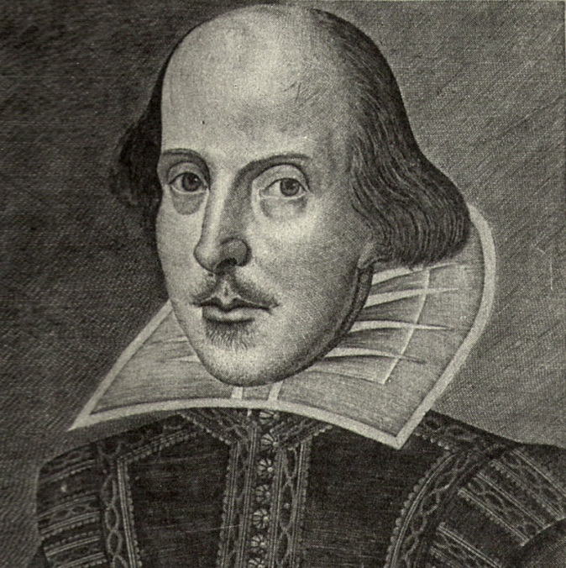
William Shakespeare 1564-1616
Family
Education
Marriage to Anne Hathaway
Established in London theatre by 1592
1594: Lord Chamberlain’s Men
1597: Purchased New Place in Stratford-upon-Avon
1603: King’s Men

Slide 3
Shakespearean Comedy
Theme of Love
Mistaken Identities
Helena in All’s Well that Ends Well
Twins: A Comedy of Errors
Gender Play
Rosalind in As You Like It
Comic word play

Slide 4
“Problem Plays” or Dark Comedies
Measure for Measure, All’s Well That End’s Well and Troilus and Cressida
Highlights problems and contradictions in society
Abuse of Power and Gender Inequality in Measure for Measure

Slide 5
Romance Plays
1608 Shakespeare wrote 4 plays: Pericles Prince of Tyre, Cymbeline, The Winter's Tale, and The Tempest
These plays are more concerned with reconciliation, magic, renewal, forgiveness, providence, music, and community.

Slide 6
The Tempest and the Unities
All of the action takes place on the island
The action unfolds in 24 hours
The plot is more complex:
Restoration to the dukedom of Milan
Marriage of daughter, Miranda, to the prince of Naples
Restoration of Political and Social Unity and Order

Slide 7
Storm and Disorder
Who is in charge? Nobles interfere with the sailors
“You are a counselor: if you can command these elements to silence, and work the peace of the present, we will not hand a rope more; use your authority.”
As the ship is wrecking, Gonzalo: “Mercy on us! We split, we split, we split!”
Metaphor for social division

Slide 8
Miranda: Natural Compassion
The child of Prospero, exiled duke of Milan, raised in the state of nature
She represents the good in mankind when we are not corrupted by ambition, greed, and society.
Seeing the ship wreck, she feels compassion and assumes those on board are “noble creatures”
When she meets Ferdinand, she falls in love immediately, seeing only the good in him.
Is he, like her, the younger generation, good? Are they different in kind from their parents and uncles? Or is it just that her native goodness sees and brings out in him what is best?

Slide 9
Theme of Division
Prospero’s plan splits the group from the ship up again
Ferdinand, prince of Naples, is brought to the camp so he can meet and fall in love with Miranda
The nobles are in one group
The servants in another

Slide 10
Is Prospero truly virtuous?
Or, is he as ambitious as his brother and as prone to manipulating those around him to his own ends?
He DOES manipulate Miranda, Caliban, and Ariel
Did he “steal” the island from Caliban?
It seems Caliban tried to rape Miranda and one way of looking at Prospero is he shows restraint in dealing with Caliban
Another view: Post-Modern interpretation—Prospero (white colonizers) and Caliban (native people enslaved and disenfranchised)

Slide 11
Caliban as Social Outcast
P: “thou poisonous slave, got by the devil himself upon they wicked dam…”
Reminiscent of Grendel from Beowulf
“This island’s mine, by Sycorax, my mother, which thou tak’st from me. When thou camest first, thou strok’st me, and mad’st much of me…[and Caliban showed him all the good things of the island]…I am all the subjects that you have, which first was mine own king;”

Slide 12
Prospero and Ariel
In Act I Ariel reminds Prospero about his promise to set Ariel free
We learn how Prospero set Ariel free from imprisonment in a pine tree
Prospero: “If thou murmur’st I will rend an oak and peg thee in his knotty entrails, til thou hast howl’d away twelve winters.”
This shows a potentially vengeful side of Prospero

Slide 13
Plot among the Nobles
Prospero’s brother, Antonio, plotted with Naples, to steal the dukedom of Milan
In Act II, Antonio plots with Sebastian, brother of the King of Naples
The parallel between the two plots is highlighted: “Sebastian: “They case, dear friend, shall be my precedent; as thou gott’st Milan, I’ll come by Naples. Draw thy sword: one stroke shall free thee from the tribute which thou pay’st; And I the king shall love you.”
Ariel disturbs the plot
Bottom line is that with the exception of Gonzalo, all the nobles are Machiavellian usurpers.

Slide 14
Low Class Characters: Revolt and Treason
Caliban discovers the servants of the ship’s nobles: Stephano and Trinculo
He pledges his service to them like gods (similar to how the Native Americans saw the Spanish as gods)
They plot to murder Prospero and become lords of the island
High and low alike are possessed by boundless ambition and are willing to betray and divide society to achieve their ends.

Slide 15
Reconciliation and Unit
In the final scene, everyone is brought together by Prospero and Ariel
The king begs forgiveness
Prospero forgives his brother, but…
The honest, innocent, and chaste love of Miranda and Ferdinand transforms the scene:
Miranda: “O, wonder! How many goodly creatures are there here! How beauteous mankind is! O brave new world that hath such people in it!”

Slide 16
Summary
Comedy ends happily with a marriage
The end of The Tempest does resolve the social division through love and forgiveness, magic and renewal.
Are we to take Miranda’s idealistic view of things as the authoritative view?
Is Prospero as kind and compassionate as he appears?
Is the magic of love as powerful as Miranda imagines it?

